Slide 1
Waterfall Model
This model is originally propose by Royce.
Diagrammatic representation of classified waterfall model resembles a multi-level waterfall.
It is known as Linear sequential life cycle model.
In Waterfall Model, phases do not overlap

Slide 2
Classical Waterfall Model
Feasibility Study
Req. Analysis
Design
Coding
Testing
Maintenance

Slide 3
Waterfall Model design
The different phases of this model are:
Feasibility study
Requirement analysis and specification
Design
Coding
Testing and integration
Maintenance
The outcome of one phase acts as the input for the next phase sequentially.

Slide 4
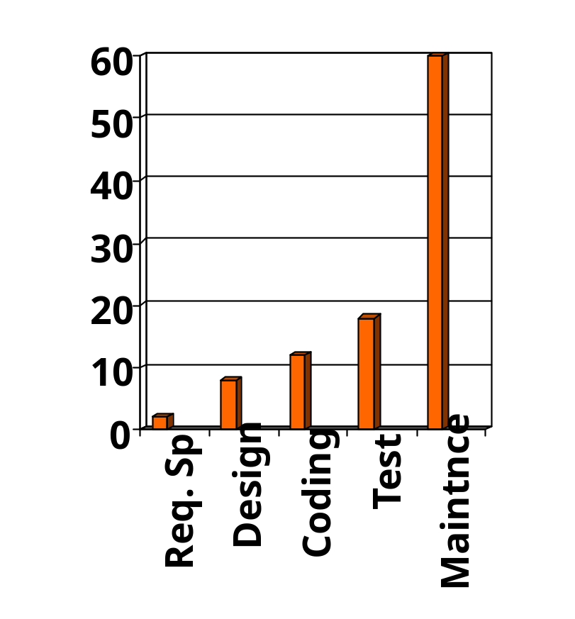
Relative Effort for Phases
Phases between feasibility study and testing
  known as development phases.
Project management activity.
Among all life cycle phases
  maintenance phase consumes maximum effort.
Among development phases,
  testing phase consumes the maximum effort.
Relative Effort

Slide 5
Feasibility Study
Main aim of feasibility study : determine whether developing the product
  financially worthwhile
  technically feasible.
First roughly understand what the customer wants:
  different data which would be input to the system,
  processing needed on these data,
  output data to be produced by the system,
  various constraints on the behaviour of the system.

Slide 6
Activities during Feasibility Study
Work out an overall understanding of the problem.
Formulate different solution strategies.
Examine alternate solution strategies in terms of:
    resources required,
    cost of development, and
    development time.

Slide 7
Activities during Feasibility Study
Perform a cost/benefit analysis:
  to determine which solution is the best.
  you may determine that none of the solutions is feasible due to:
    high cost,
    resource constraints,
    technical reasons.

Slide 8
Requirements Analysis and Specification
Aim of this phase:
  understand the exact requirements of the customer,
  document them properly.
Consists of two distinct activities:
  requirements gathering and analysis
  requirements specification.

Slide 9
Requirements Gathering
Gathering relevant data:
  usually collected from the end-users through interviews and discussions.
  For example, for a business accounting software:
    interview all the accountants of the organization to find out their requirements.

Slide 10
Goals of Requirements Analysis
  analyze the collected data to clearly understand what the customer wants,
  find out any inconsistencies and incompleteness in the requirements,
  resolve all inconsistencies and incompleteness.

Slide 11
Requirements Analysis (CONT.)
The data you initially collect from the users:
  would usually contain several contradictions and ambiguities:
  each user typically has only a partial and incomplete view of the system.

Slide 12
Requirements Analysis (CONT.)
Ambiguities and contradictions:
  must be identified
  resolved by discussions with the customers.
Next, requirements are organized:
  into a Software Requirements Specification (SRS) document.

Slide 13
Requirements Analysis (CONT.)
Engineers doing requirements analysis and specification:
  are designated as analysts.
Three important contents of SRS:
Functional requirements
Non-functional requirements
Goals of implementation
Contract between customer and developers.

Slide 14
Design
Design phase transforms requirements specification:
  into a form suitable for implementation in some programming language.

Slide 15
Design
In technical terms:
  during design phase, software architecture is derived from the SRS document.
Two design approaches:
  traditional approach,
  object oriented approach.

Slide 16
Traditional Design Approach
Based on data flow oriented design approach.
Consists of two activities:
  Structured analysis
  Structured design

Slide 17
Structured Analysis Activity
Identify all the functions to be performed.
Identify data flow among the functions.
Decompose each function recursively into sub-functions.
- Identify data flow among the sub functions as well.
After structured analysis, carry out structured design:
  architectural design (or high-level design)
  detailed design (or low-level design).

Slide 18
Structured Design
High-level design:
  decompose the system into modules,
  represent relationships among the modules.
Detailed design:
  different modules designed in greater detail:
    data structures and algorithms for each module are designed.

Slide 19
Object Oriented Design
First identify various objects (real world entities) occurring in the problem:
  identify the relationships among the objects.
  For example, the objects in a pay-roll software may be:
    employees,
    managers,
    pay-roll register,
    Departments, etc.

Slide 20
Object Oriented Design (CONT.)
OOD has several advantages:
  lower development effort,
  lower development time,
  better maintainability.

Slide 21
Implementation
Coding phase is known as implementation phases.
Purpose of implementation phase (coding phase):
  translate software design into source code.

Slide 22
Implementation
During the implementation phase:
  each module of the design is coded,
  each module is unit tested
    tested independently as a stand alone unit, and debugged,
  each module is documented.

Slide 23
Implementation (CONT.)
The end product of implementation phase:
  - a set of program modules that have been tested individually.
The purpose of unit testing:
  test if individual modules work correctly.

Slide 24
Integration and System Testing
Different modules are integrated in a planned manner:
  modules are almost never integrated in one shot.
  Normally integration is carried out through a number of steps.
During each integration step,
  the partially integrated system is tested.

Slide 25
System Testing
After all the modules have been successfully integrated and tested:
  system testing is carried out.
Goal of system testing:
  ensure that the developed system functions according to its requirements as specified in the SRS document.

Slide 26
System Testing cont..
System testing consists of three activities:
α- testing
β –testing
Acceptance testing
System testing is carried out according system test plan and results are documented in form of test report.

Slide 27
Maintenance
Maintenance of any software product:
  requires much more effort than the effort to develop the product itself.
  development effort to maintenance effort is typically 40:60.

Slide 28
Maintenance (CONT.)
It performs one of the following three activities:
Corrective maintenance:
  Correct errors which were not discovered during the product development phases.
Perfective maintenance:
  Improve implementation of the system
  enhance functionalities of the system.
Adaptive maintenance:
  Port software to a new environment,
    e.g. to a new computer or to a new operating system.

Slide 29
Waterfall Model Application
Some situations where the use of Waterfall model is most appropriate are:
Requirements are very well documented, clear and fixed.
Product definition is stable.
Technology is understood and is not dynamic.
There are no ambiguous requirements.
Ample resources with required expertise are available to support the product.
The project is short.

Slide 30
Advantages
Simple and easy to understand and use
Easy to manage as each phase has specific
deliverables and a review process.
Phases are processed and completed
one at a time.
Clearly defined stages.
Well understood milestones.
Easy to arrange tasks.
Process and results are well documented.

Slide 31
Disadvantages
It is document driven process.
Not a good model for complex and object-oriented projects.
Poor model for long and ongoing projects.
Not suitable for the projects where requirements are at a moderate to high risk of changing.
Freezing the requirements requires choosing the hardware earlier.

Slide 32
Iterative Waterfall Model
Classical waterfall model is idealistic:
  assumes that no defect is introduced during any development activity.
  in practice:
    defects do get introduced in almost every phase of the life cycle.

Slide 33
Iterative Waterfall Model (CONT.)
Rather than linear model it has to be iterative as name suggests.
The main change in classical waterfall model is:
- to provide feedback paths from every phase to its preceding phases.
Feedback paths allows correction of errors committed during a phase as and when they are detected in later phases.

Slide 34
Iterative Waterfall Model (CONT.)
Feasibility Study
Req. Analysis
Design
Coding
Testing
Maintenance

Slide 35
Iterative Waterfall Model (CONT.)
Once a defect is detected:
  we need to go back to the phase where it was introduced
  redo some of the work done during that and all subsequent phases.
For example:
  if a design problem is detected in the design phase itself,
    the problem can be taken care of much more easily than, if it is identified at the end of the integration and system testing phase.

Slide 36
Phase containment of errors
The principle of detecting errors as close to its point of introduction as possible:
  is known as phase containment of errors.
Phase containment of errors can be achieved:
  By conducting reviews after every milestone.
Iterative waterfall model is most widely used model.
  Almost every other model is derived from the waterfall model.

